Slide 1
Changes in the Earth System
November 5, 2019

Slide 2
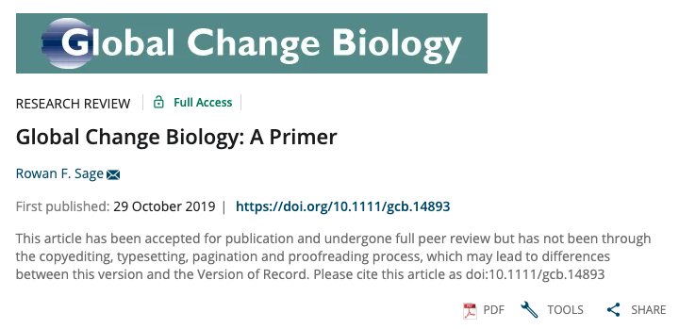

Slide 3
Have we entered a new epoch?

Slide 4
The Case for the Anthropocene
Proposed new epoch that has resulted primarily from human changes to the planet’s:
Elemental cycles
Climate
Biological diversity

Slide 5
The Case for the Anthropocene
Proposed new epoch that has resulted primarily from human changes to the planet’s:
Elemental cycles
Climate
Biological diversity

Slide 6
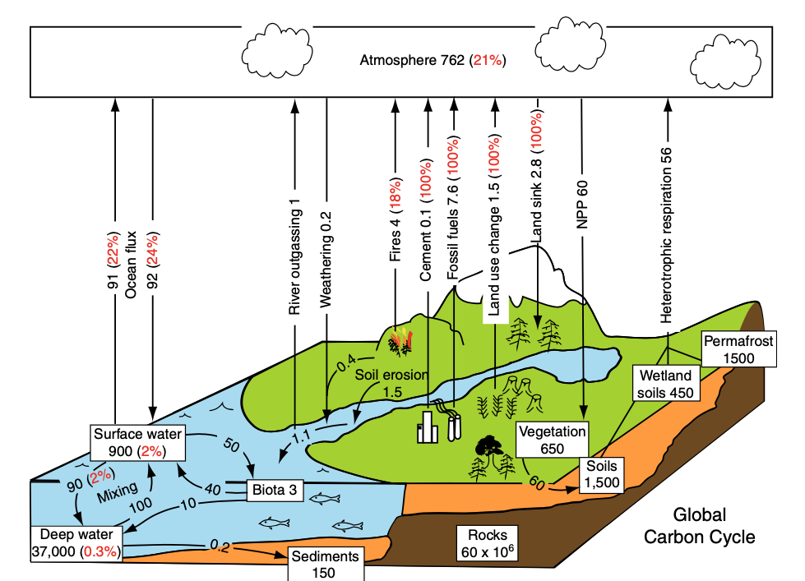
Chapin et al. (2011)

Slide 7
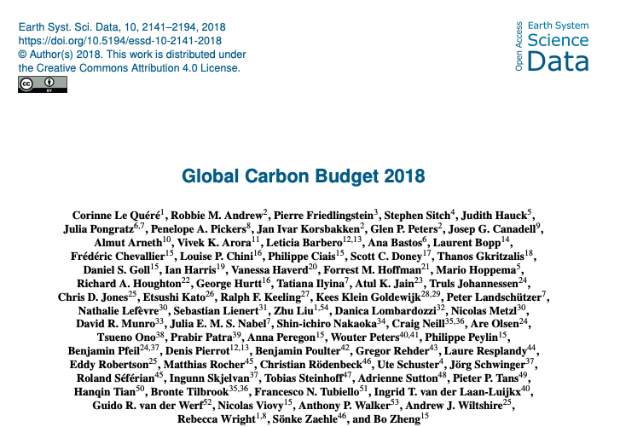
CO₂ is increasing in the atmosphere
Flux | Amount (Pg C/yr)
Fossil fuel burning | 9.4
LULCC | 1.5
Ocean uptake | 2.4
Land uptake | 3.2
Atmospheric growth | 4.7
Uncertainty | 0.5

Slide 8
CO₂ is increasing in the atmosphere
Flux | Amount (Pg C/yr)
Fossil fuel burning | 9.4
LULCC | 1.5
Ocean uptake | 2.4
Land uptake | 3.2
Atmospheric growth | 4.7
Uncertainty | 0.5
0.6 higher than book estimate (2007)

Slide 9
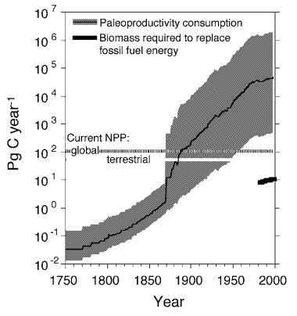
We are using more carbon than plants are putting back
Dukes (2003) “Burning buried sunshine”
Consumption if we switched to biofuels

Slide 10
Going up 5 ppm / year

Slide 11
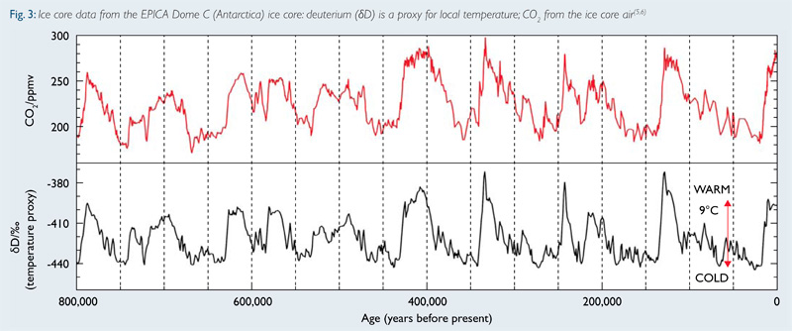
Historical rate of change: 0.002 ppm / year

Slide 13
Caron from methane (CH4) is also going up

Slide 15
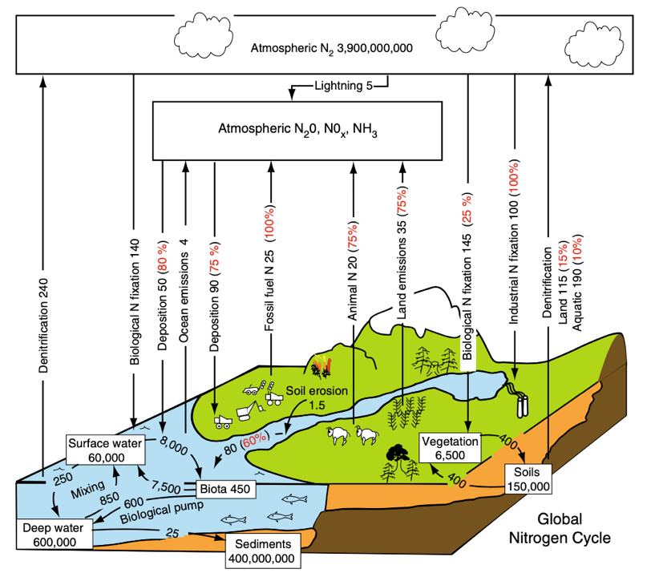
Chapin et al. (2011)

Slide 16
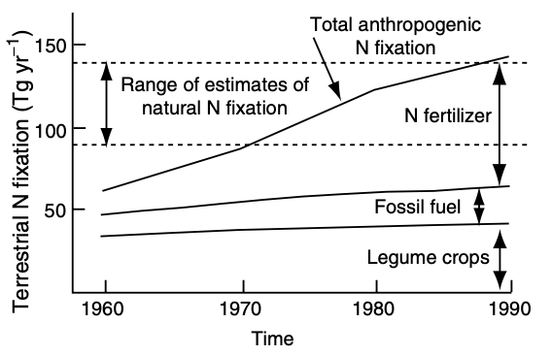
We’re pulling in a lot of atmospheric N…

Slide 17
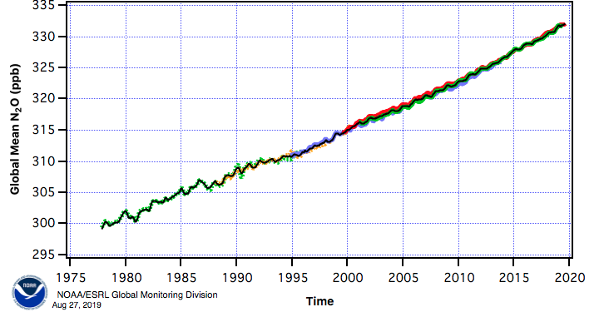
…while also pumping out a lot in new forms

Slide 19
How might US emissions differ from global emissions??

Slide 20
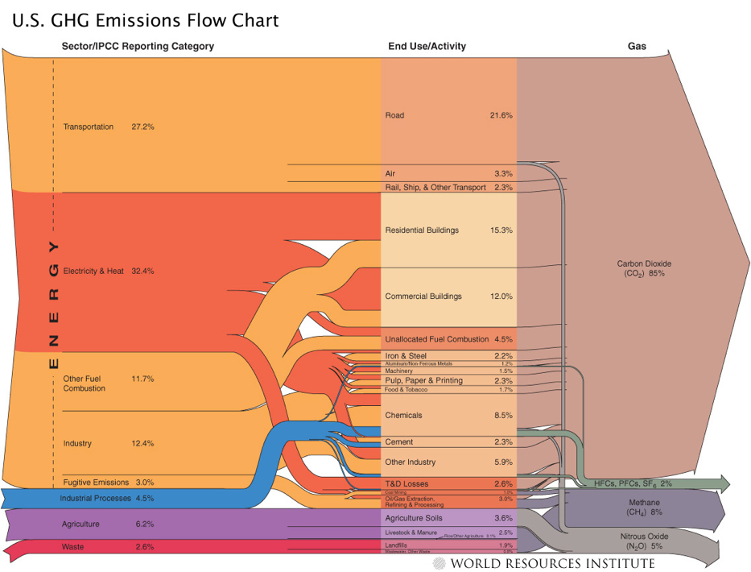

Slide 21
The Case for the Anthropocene
Proposed new epoch that has resulted primarily from human changes to the planet’s:
Elemental cycles
Climate
Biological diversity

Slide 22
Climate change is the result of human changes to elemental cycles

Slide 23
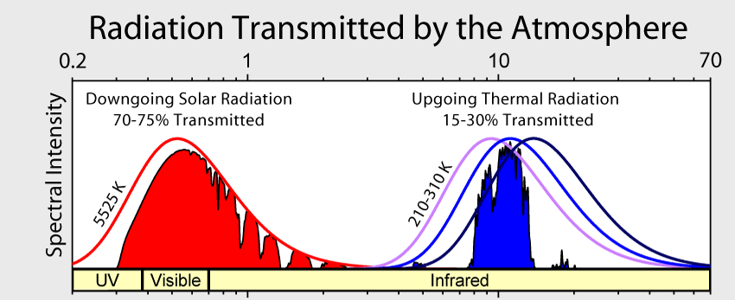

Slide 24
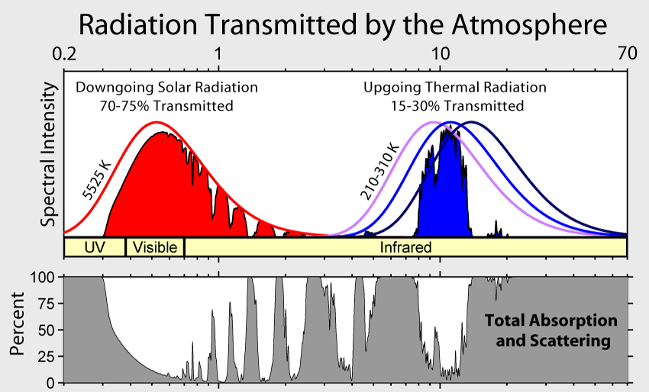

Slide 25
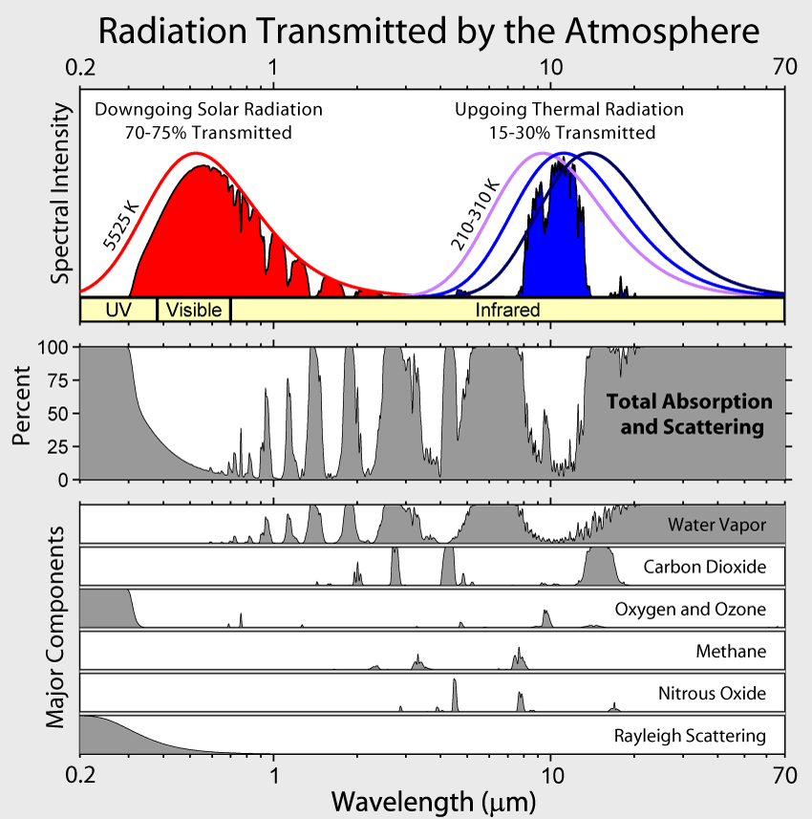

Slide 26
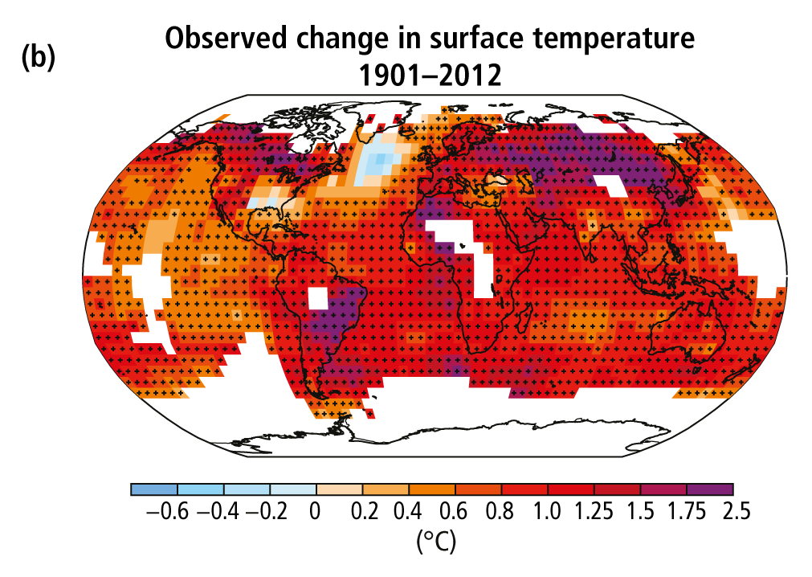
The climate is warming
Poles and land are warming the fastest
IPCC (2013)

Slide 27
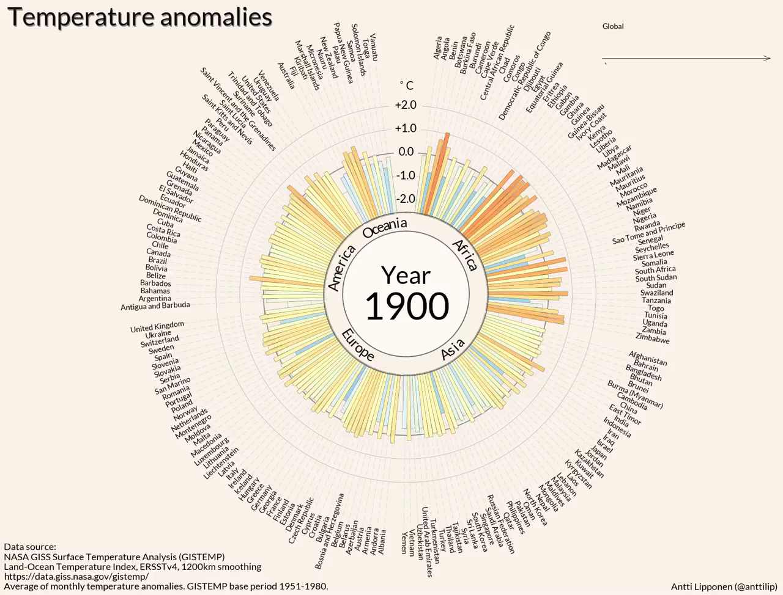

Slide 28
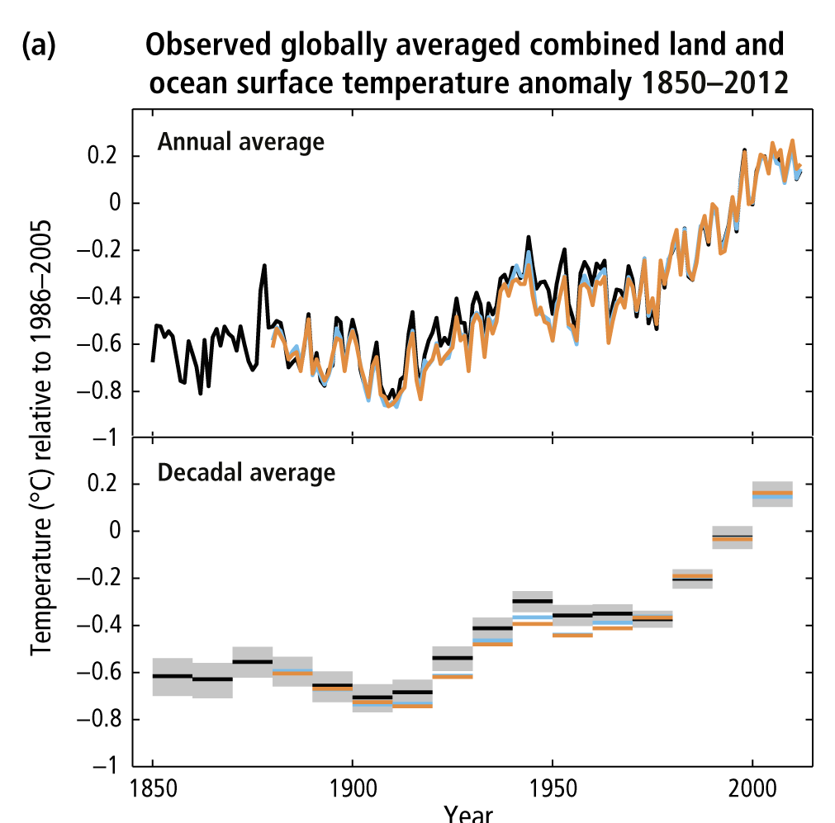
The global mean temperature has increased ~1.5º F (0.8º C) over the past 150 years
IPCC (2013)
Notes:
Figure SPM.1: (a) Observed global mean combined land and ocean surface temperature anomalies, from
1850 to 2012 from three data sets. Top panel: annual mean values, bottom panel: decadal mean values
including the estimate of uncertainty for one dataset (black). Anomalies are relative to the mean of
1961−1990. For a listing of the datasets and further technical details see the Technical Summary Supplementary
Material. {Figures 2.19–2.21; Figure TS.2}

Slide 29

It’s warmer now than 150 years ago
The global mean temperature has increased ~1.5º F (0.8º C) over the past 150 years
IPCC (2013)

Slide 30
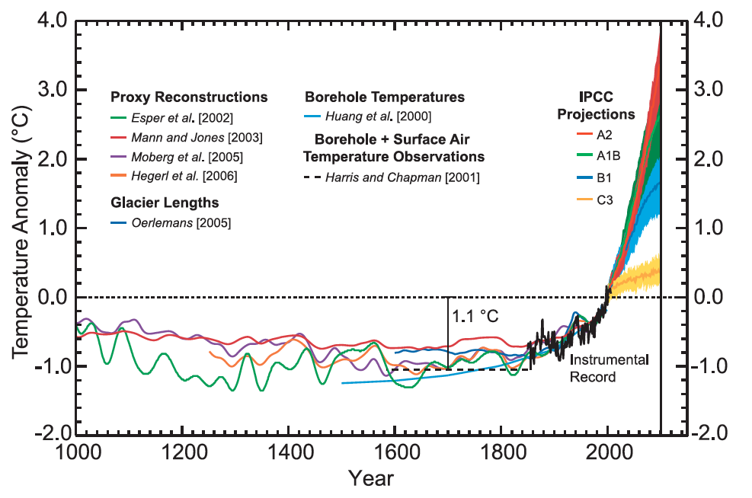
And warmest it’s been in the past 1000 years
Chapman & Davis (2010)

Slide 31
As a result sea levels are rising

Slide 32
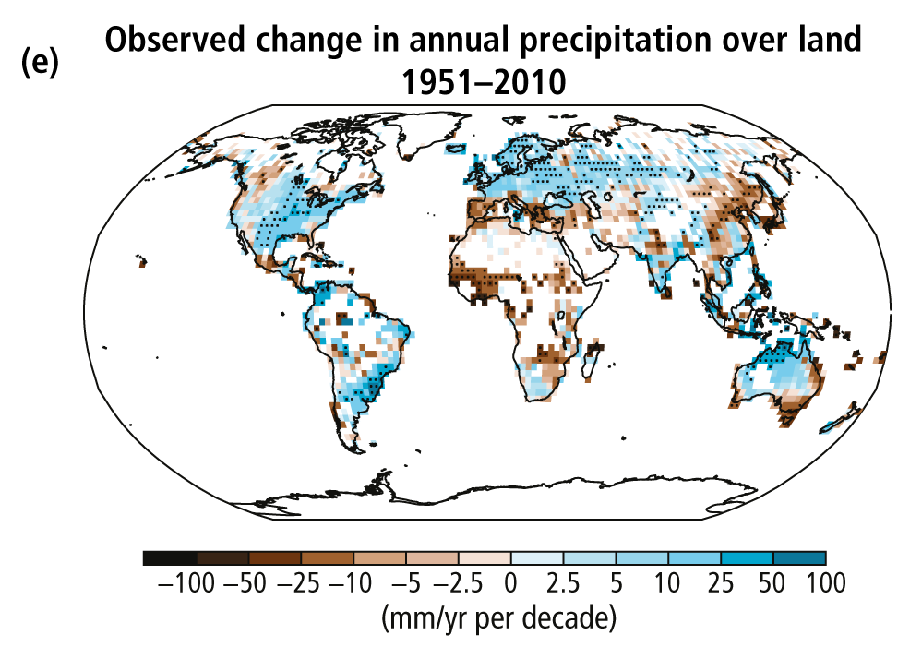
Global total precipitation is also changing
IPCC (2013)

Slide 33
As is precipitation variability
Increase in heaviest 1% precipitation (U. Michigan)

Slide 34
The Case for the Anthropocene
Proposed new epoch that has resulted primarily from human changes to the planet’s:
Elemental cycles
Climate
Biological diversity

Slide 35
Humans are threatening species of all types
IPBES

Slide 36
And the threat is increasing
IPBES

Slide 37
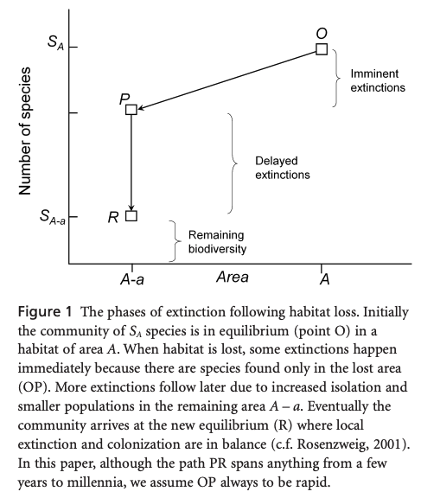

Species loss results from habitat loss

Slide 38
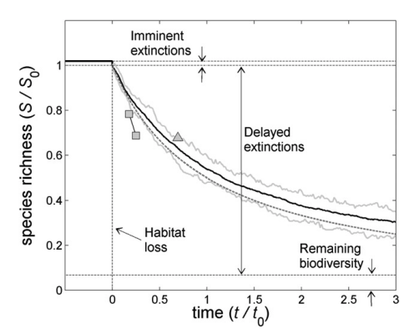
Species loss results from habitat loss

Slide 39
Invasive species are spreading…

Slide 40
Invasives are a threat everywhere
Why more of a threat some places than others?
Early et al. (2016)

Slide 41
Early et al. (2016)

Slide 42
Early et al. (2016)

Slide 43
The Case for the Anthropocene
Proposed new epoch that has resulted primarily from human changes to the planet’s:
Elemental cycles
Climate
Biological diversity

Slide 44


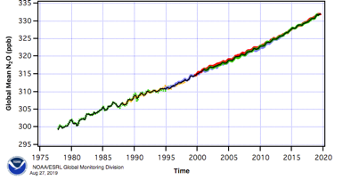
The Case for the Anthropocene
Do you buy it?

Slide 45
The Case for the Anthropocene
Does it matter?

Slide 46
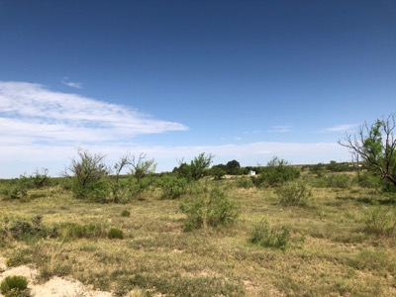
Class activity (in pairs)
1. Pick an ecosystem service provided by West Texas ecosystems
Food
Fiber
Pollination
Water purity
Air purity
Energy
Climate regulation
Pest & disease control
Culture
History
Spiritual services
Recreation
Science Education
Therapy
2. Use a systems diagram to indicate how it will be impacted by global change

